Slide 2


Slide 3


Slide 4


Slide 5

Statistics
ANK
ELECTION
RITERIA
BSC

Slide 6

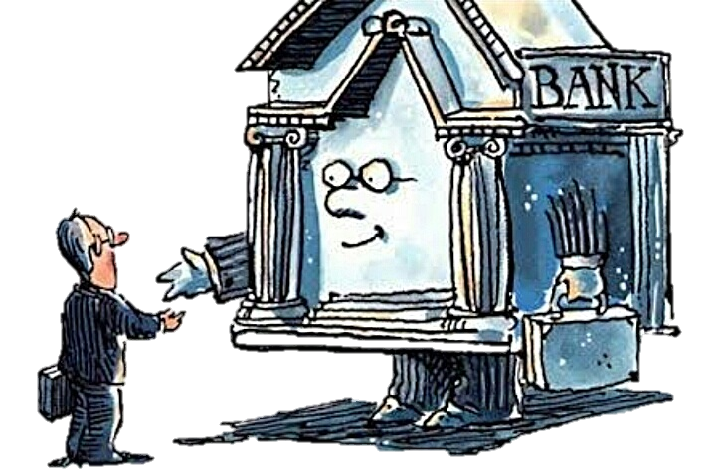

Slide 7

INTRODUCTION
The trend towards globalization has introduced many changes in the Economic and Business environment all over the world.
With rapidly changing economic environment, more demanding and sophisticated customers growing competitiveness in Banking Industry and similarity of services offered by Bank, it has become important for the financial institutions to determine the basis on which customers (both depositors and borrowers) choose between providers of financial services.
In general people will choose the bank that they perceive provides the greatest reward or benefits at lowest cost, given their preference.
The provision of products and services of high quality enhances reputation, improves customers retention, attracts new customers and increase financial performance and profitability.

Slide 8


OBJECTIVES
To identify the socio-demographic factors that influence people to select Public bank.
To identify the socio-demographic factors that influence people to select Private bank.
To determine the criteria that customers consider important when selecting a bank.
To identify whether there is any significant difference in bank selection criteria among the demographic (Gender , Age , Education level , Income level, Housing conditions) groups of customers.
To rank the levels of each socio-demographic groups according to the importance they give to each factors.

Slide 9

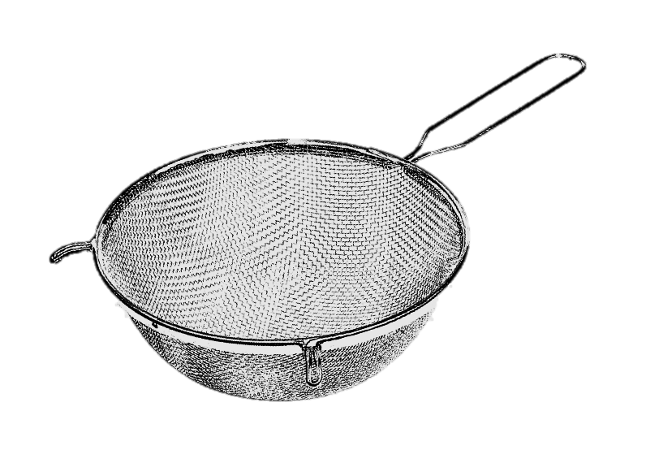
DATA CLEANING
Sample Size & Sampling Technique
Pilot Study Sample Size = 30
Sampling Technique = convenience sampling
Total Sample Size = 1014
Sample Size for Model fitting = 962

Slide 10
DATA CLEANING
1
0
1
4
1014
962

Slide 11

Preparatory Phase
Designing the Questionnaire
Pilot Survey
Modification of Questionnaire
Actual Survey
Data Cleaning
Coding Of Data
Analysis of Data
Interpretation
Conclusions
METHODOLOGY

Slide 12


GRAPHICAL REPRESENTATION

Slide 15
TYPES OF SERVICES

Slide 16


ANALYSIS

Slide 17


OBJECTIVE - 1
To identify the socio-demographic factors that influence people to select Public bank.

Slide 18


Slide 19


BINARY
LOGISTIC REGRESSION

Slide 20

962
People
Public
Socio-demographic
Groups
Gender
Occupation
Male
Female
Housewives
Students
Others

Slide 21
Dependent Variable 1 : Public Banks
Y = 1 Public Bank Account Holders
Y = 0 Non-Public Bank Account Holders
Independent Variables:
sd1: Area
sd11 = Mumbai
sd12 = Thane
sd13 = Navi Mumbai
sd5: Religion
sd51 = Hindu
sd52 = Muslim
sd53 = Christian
sd54 = Sikh
sd55 = Buddhism
sd56 = Others
sd7: Education Level
sd71 = Below SSC
sd72 = SSC
sd73 = HSC
sd74 = Graduate
sd75 = Post Graduate
sd76 = Professional Course
sd11: Father’s Education
sd11 = Below SSC
sd112 = SSC
sd113 = HSC
sd114 = Graduate
sd115 = Post Graduate
sd116 = Professional Course
sd14: No. of Family
Members
sd15: No. of Earning
Members in Family
sd2: Age group
sd21 = 15-25
sd22 = 25-35
sd23 = 35-45
sd24 = 45+
sd6: Caste
sd61 =Open
sd62 =OBC
sd63 =SC/ST
sd64 =NT/DT
sd65 =Others
sd9: Income p.a.
Sd91 = Dependent person
Sd92 = Less Than 1lakh
Sd93 = 1-2lakhs
Sd94 = 2-5lakhs
Sd95 = Above 5 lakhs
sd12: Mother’s Education
sd121 = Below SSC
sd122 = SSC
sd123 = HSC
sd124 = Graduate
sd125 = Post Graduate
sd126 = Professional Course
sd3: Gender
sd31 = Male
sd32 = Female
sd8: Occupation
sd81 = Housewife
sd82 = Private Sector
sd83 = Public Sector
sd84 = Student
sd85 = Self-Employed
sd86 = Others
sd10: Housing condition
sd101 = Slum
sd102 = Chawl
sd103 = Building
sd104 = Luxurious apartment
sd13: Type of family
sd131 = Joint
sd132 = Nuclear
sd4: Marital Status
sd41 = Married
sd42 = Unmarried

Slide 22
PUBLIC

Slide 23
GLOBAL TESTING
Hypothesis:
H_{o}: All independent variables are insignificant
i.e. β₁ = β₂= …..= β₁₅=0.
H₁: At least one of the independent variable is significant.
Test Criterion:
Reject H₀ if p-value <0.05
SAS OUTPUT FOR GLOBAL TESTING
Conclusion:
The p-value of the Likelihood Ratio Test is less than 0.05 and hence at least one of the variables is significant at 5% level of significance

Slide 24
STEPWISE SELECTION
SAS OUTPUT FOR STEPWISE SELECTION
Applying STEPWISE SELECTION regression procedure, in first 2 steps the variables entered were sd8 & sd10. After step 2, no (additional) effects met the 0.05 significance level for entry into the model. Therefore, sd8(Occupation) & sd10(Housing Condition) are only effects which are significant and hence included in the model

Slide 25
RESIDUAL CHI-SQUARE
Hypothesis:
H₀: The remaining independent variables are not significant.
H₁: The remaining independent variables are significant .
Since the p-value > 0.05, we do not reject H₀ . Hence the remaining independent variables are not significant and we proceed with the 2 variables given by the stepwise procedure.

Slide 26
WALD STATISTICS (INDIVIDUAL TESTING)
Hypothesis:
H₀: β_{i} = 0 ; i = 8, 10
H₁: β_{i} ≠ 0 ; for at least one
From the table of Analysis of effects, the p-value of all the variables is less than 0.05. Thus the variables sd8 and sd10 are significant at 5% level of significance.

Slide 27
ODDS RATIO
People who select public banks are 0.359 times less likely to be present in private sector than in housewives.

Slide 28
ODDS RATIO INTERPRETATION
Significant variables for public bank:
Occupation:
People who select public banks are 0.359 times less likely to be present in private sector than in housewives.
People who select public banks are 0.279 times less likely to be present in public sector than in housewives.
People who select public banks are 0.684 times less likely to be present in students than in housewives.
People who select public banks are 0.327 times less likely to be present in self-employed than in housewives.
People who select public banks are 0.513 times less likely to be present in other occupation (apart from private, public, student and self-employed people) than in housewives.

Slide 29
Housing Conditions:
People who select public banks are 1.270 times more likely to be present in chawl than in slums.
People who select public banks are 0.789 times less likely to be present in buildings than in slums.
People who select public banks are 0.595 times less likely to be present in luxurious apartment than in slums.

Slide 30
HOSMER & LEMESHOW (TEST FOR GOODNESS OF FIT)
Hypothesis:
H₀:Model is a good fit.
H₁:Model is not a good fit.
Decision Criteria:
Reject H₀ for large values of Chi-square i.e. if p-value < 0.05
Conclusion :
Since the p-value > 0.05, we do not reject H₀ . Hence the reduced model is good fit.

Slide 31
SAS OUTPUT FOR ESTIMATES AND INDIVIDUAL TESTING

Slide 32
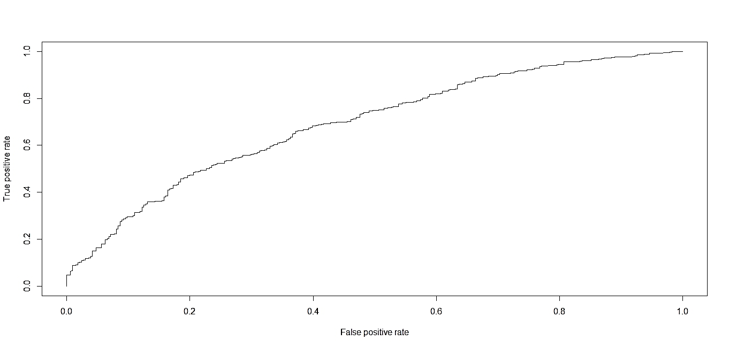
ROC CURVE

Slide 33
SAS OUTPUT
Conclusion:
Area under the ROC curve is estimated by the statistic c in the "Association of Predicted Probabilities and Observed Responses" table. Hence, the area under the ROC curve is 0.646
Since, our ROC curve rises quickly i.e. both sensitivity and specificity are high (thus 1-specificity is low). Hence our model has high predictive accuracy.

Slide 34
OBJECTIVE - 2
To identify the socio-demographic factors that influence people to select Private bank.

Slide 35

BINARY
LOGISTIC REGRESSION

Slide 36
962
People
Private
Socio-demographic
Groups
Gender
Occupation
Male
Female
Housewives
Students
Others

Slide 37
Dependent Variable 1 : Private Banks
Y = 1 Private Bank Account Holders
Y = 0 Non-Private Bank Account Holders
Independent Variables:
sd1: Area
sd11 = Mumbai
sd12 = Thane
sd13 = Navi Mumbai
sd5: Religion
sd51 = Hindu
sd52 = Muslim
sd53 = Christian
sd54 = Sikh
sd55 = Buddhism
sd56 = Others
sd7: Education Level
sd71 = Below SSC
sd72 = SSC
sd73 = HSC
sd74 = Graduate
sd75 = Post Graduate
sd76 = Professional Course
sd11: Father’s Education
sd11 = Below SSC
sd112 = SSC
sd113 = HSC
sd114 = Graduate
sd115 = Post Graduate
sd116 = Professional Course
sd14: No. of Family
Members
sd15: No. of Earning
Members in Family
sd2: Age group
sd21 = 15-25
sd22 = 25-35
sd23 = 35-45
sd24 = 45+
sd6: Caste
sd61 =Open
sd62 =OBC
sd63 =SC/ST
sd64 =NT/DT
sd65 =Others
sd9: Income p.a.
Sd91 = Dependent person
Sd92 = Less Than 1lakh
Sd93 = 1-2lakhs
Sd94 = 2-5lakhs
Sd95 = Above 5 lakhs
sd12: Mother’s Education
sd121 = Below SSC
sd122 = SSC
sd123 = HSC
sd124 = Graduate
sd125 = Post Graduate
sd126 = Professional Course
sd3: Gender
sd31 = Male
sd32 = Female
sd8: Occupation
sd81 = Housewife
sd82 = Private Sector
sd83 = Public Sector
sd84 = Student
sd85 = Self-Employed
sd86 = Others
sd10: Housing condition
sd101 = Slum
sd102 = Chawl
sd103 = Building
sd104 = Luxurious apartment
sd13: Type of family
sd131 = Joint
sd132 = Nuclear
sd4: Marital Status
sd41 = Married
sd42 = Unmarried

Slide 38
PRIVATE

Slide 39
GLOBAL TESTING
Hypothesis:
H_{o}: All independent variables are insignificant
i.e. β₁ = β₂= …..= β₁₅=0.
H₁: At least one of the independent variable is significant.
Test Criterion:
Reject H₀ if p-value <0.05
SAS Output For GLOBAL TESTING
Conclusion:
The p-value of the Likelihood Ratio Test is less than 0.05 and hence at least one of the variables is significant at 5% level of significance

Slide 40
STEPWISE SELECTION
SAS OUTPUT FOR STEPWISE SELECTION
Applying STEPWISE SELECTION regression procedure, in first 2 steps the variables entered were sd9 & sd11. After step 2, no (additional) effects met the 0.05 significance level for entry into the model. Therefore, sd9 (Income) and sd11 (Father’s Education) are only effects which are significant and hence included in the model.

Slide 41
RESIDUAL CHI-SQUARE
Hypothesis:
H₀: The remaining independent variables are not significant.
H₁: The remaining independent variables are significant.
Since the p-value > 0.05, we do not reject H₀ . Hence the remaining independent variables are not significant and we proceed with the 2 variables given by the stepwise procedure.

Slide 42
WALD STATISTICS (INDIVIDUAL TESTING)
Hypothesis:
H₀: β_{i} = 0 ; i = 9,11
H₁: β_{i} ≠ 0 ; for at least one
From the table of Analysis of effects , the p-value of all the variables is less than 0.05 . Thus the variables sd9 and sd11 are significant at 5% level of significance.

Slide 43
ODDS RATIO
People who select private banks are 0.883 times less likely to be present in Less than 1 Lakh than in Dependent persons.

Slide 44
ODDS RATIO INTERPRETATION
Significant variables for private bank:
Father’s Education:
People who select private banks are 0.979 times less likely to be present in SSC than in Below SSC.
People who select private banks are 1.14 times more likely to be present in HSC than in Below SSC.
People who select private banks are 2.041 times more likely to be present in Graduate than in Below SSC.
People who select private banks are 1.58 times more likely to be present in Post Graduate than in Below SSC.
People who select private banks are 2.45 times more likely to be present in Professional course than in Below SSC.

Slide 45
Income:
People who select private banks are 0.883 times less likely to be present in Less than 1 Lakh than in Dependent persons.
People who select private banks are 1.664 times more likely to be present in 1-2 Lakh than in Dependent persons.
People who select private banks are 1.681 times more likely to be present in 2-5 Lakhs than in Dependent persons.
People who select private banks are 2.745 times more likely to be present in Above 5 Lakh than in Dependent persons.

Slide 46
HOSMER & LEMESHOW (TEST FOR GOODNESS OF FIT)
Hypothesis:
H₀: Model is a good fit.
H₁: Model is not a good fit.
Decision Criteria:
Reject H₀ for large values of Chi-square i.e. if p-value < 0.05
Conclusion:
Since the p-value > 0.05, we do not reject H₀ . Hence the reduced model is good fit.

Slide 47
SAS OUTPUT FOR ESTIMATES AND INDIVIDUAL TESTING

Slide 48
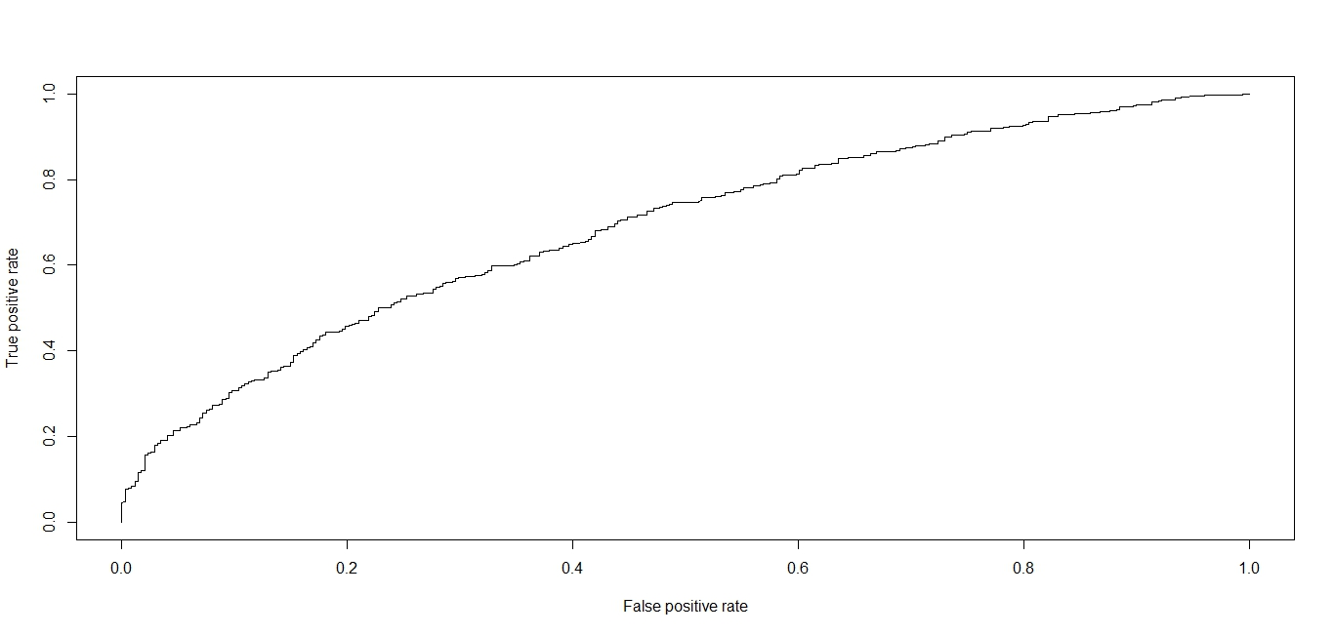
ROC CURVE

Slide 49
SAS OUTPUT
Conclusion:
Area under the ROC curve is estimated by the statistic c in the "Association of Predicted Probabilities and Observed Responses" table. Hence, the area under the ROC curve is 0.641.
Since, our ROC curve rises quickly i.e. both sensitivity and specificity are high (thus 1-specificity is low). Hence our model has high predictive accuracy.

Slide 50
OBJECTIVE - 3
To determine the criteria that customers consider important when selecting a bank.

Slide 51


FACTOR ANALYSIS

Slide 52
F1
F2
33
Variables
Fi

Slide 53
What is Factor Analysis ?
Factor analysis is a useful method of reducing data complexity by reducing the number of variables under study
It is a set of techniques which analyses correlations between variables, and reduces their number into fewer uncorrelated and unobservable “factors” which explain much of the original data, more economically
Basic Steps In Factor Analysis
Calculate a correlation matrix of all variables to be used in the analysis
Extract the factors. (Method used: Principal Component Analysis)
Rotate to create a more understandable factor structure (Method used is Varimax)
Interpret the results

Slide 54
VARIABLES
F1 : Convenient location of bank and its main branches.
F2 : Extended operation hours (i.e. Saturday’s, evening, etc).
F3 : Recommendation from family/relatives.
F4 : Recommendation from friends/colleagues.
F5 : Availability of ATM in several locations.
F6 : Convenient ATM locations.
F7 : Low interest rate on loans.
F8 : High interest rate on savings.
F9 : Low service charge on products/services.
F10: Internet/Online banking facility.
F11: Parking facility.
F12: Phone banking facility.
F13: Friendly/pleasing manners of staff.
F14: Transactions Alert and regular communication with customers.
F15: Ease of opening an account.
F16: Low account fees.
F17: Fast and efficiency services.
F18: Reputation and image of bank.
F19: External appearance of bank.
F20: Knowledge, skill and expertise of staff.
F21: Seating arrangement.
F22: Appearance and attire of staff.
F23: Interior designs of bank.
F24: Type of bank (Public/Private).
F25: Pleasant bank atmosphere and sufficient facilities.
F26: Reliability of staff.
F27: Security management.
F28: Financial stability of bank.
F29: Connectivity to others bank’s ATMs.
F30: More number of branches.
F31: Minimum account balance.
F32: Latest Technology and Services.
F33: Availability of different banking cards.
(Debit , Credit card , etc)

Slide 55
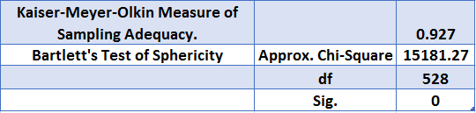
KMO TEST
Hypothesis:
H0: Population correlation matrix is identity matrix
H1: Population correlation matrix is not identity matrix
Decision criteria:
Null hypothesis is rejected by Bartlett’s test of sphericity
Conclusion:
The value of KMO statistics is 0.927 is large (>0.5). Hence, we proceed with Factor Analysis as an appropriate technique of data reduction. Note that the correlation matrix used is Polychoric Correlation Matrix since our data is ordinal.

Slide 56
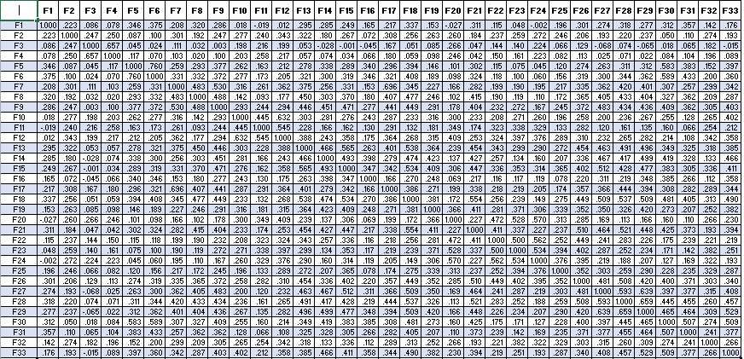
Polychoric Correlation Matrix

Slide 57
SCREE PLOT

Slide 58
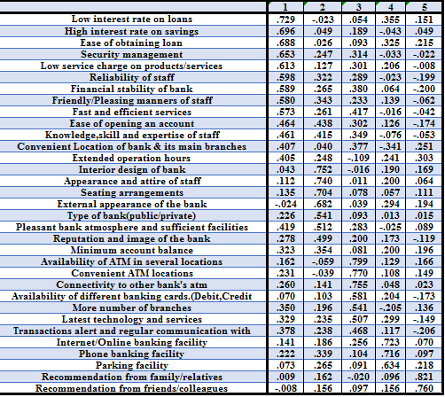
Customer Friendly Services
Characteristics Of Bank
Additional Facilities
Convenient & Required Facilities
Recommendation From People

Slide 59
FACTOR 1
(Customer friendly Services)
Low interest rate on loans.
High interest rate on saving.
Ease of obtaining loan.
Security management.
Low service charge on product/service.
Reliability of staff.
Financial stability of Bank.
Friendly/pleasing manners of staff.
Fast and Efficiency services.
Knowledge/skill and expertise of staff.
Extended operation hours.
Convenient location of bank and its main branches.
Ease of opening an account.
FACTOR 2
(Characteristics of Bank)
Interior design of Bank.
Appearance and attire of staff.
Seating arrangement.
External appearance of Bank.
Types of Bank (Public/Private).
Pleasant bank atmosphere and sufficient facilities.
Reputation and image of Bank.
Minimum account balance.

Slide 60
FACTOR 4
(Additional Facilities)
Internet/Online banking facility.
Phone banking facility.
Parking facility.
FACTOR 3
(Convenient and Required Facilities)
Availability of Convenient ATM location.
Availability of ATM in several location.
Connectivity to other banks ATM.
More no. of branches.
Availability of different banking cards.
Latest technology and services.
Transaction alert & regular interaction with customers.
FACTOR 5
(Recommendation From People)
Recommendation from family/ relatives.
Recommendation from friends/ colleagues.

Slide 61
OBJECTIVE - 4
To identify whether there is any significant difference in bank selection criteria among the demographic (Gender, Age, Education level, Income level, Housing conditions) groups of customers.

Slide 62
F1
33
Variables
F2
962
People
F5
Socio-demographic
Groups
Gender
Occupation
Male
Female
Housewives
Students
Others

Slide 63
FACTOR SCORES
Intuitively , factors are latent variables that underlie the scores in your observed variables. Usually the interpretation of each of these factors is based on the content of original variables so that each factor is interpreted as whatever the attributes with high loadings for this particular factor have in common.
Factor scores are estimated values of the factors in factor analysis. Under this process , the computed factor scores are standardized to a mean of 0;however the standard deviation of the distribution of factor scores (by factor) will be 1 if principal component methods are used and will be the squared multiple correlation between factors and variables (typically used as communality estimate) if principal axis methods are used.
Ideally , factor scores would therefore represent the score of each person on the underlying latent variable. The score of 0 on a factor therefore means that this persons ratings on the importance of relevant attributes is close to the average of your sample. Similarly a negative score means that the person gave lower than average importance ratings and vice-versa (all this holds for variables with positive loadings , for negative loadings the relationship is inverted i.e positive factor scores would correspond to lower than average ratings.)

Slide 64
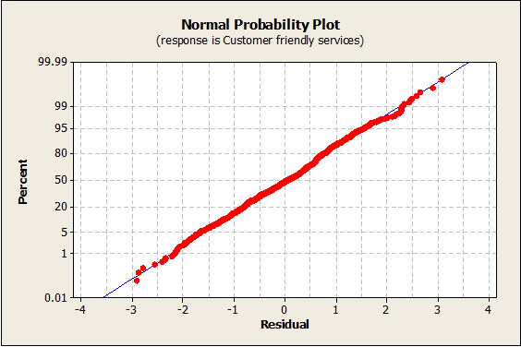
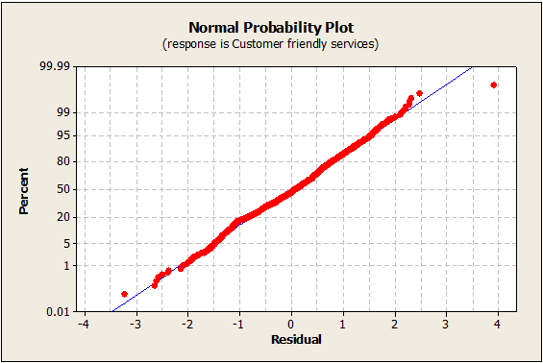
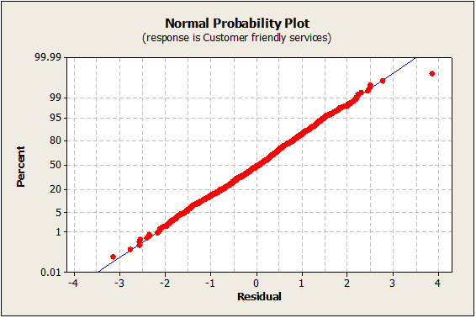
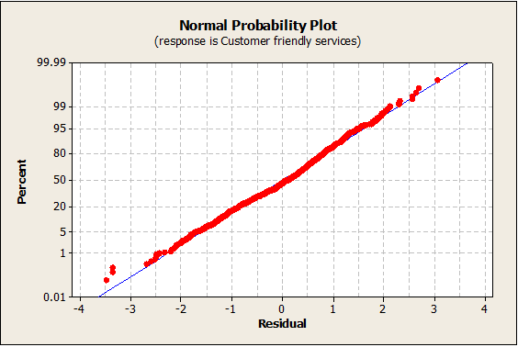

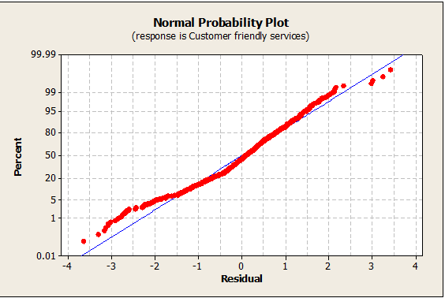
CHECKING OF NORMALITY ASSUMPTION

Slide 65
GENDER (T-TEST)
_{Hypothesis:}
H₀ : There is no significant difference between males and females with respect to factor Fi ; i =1,2,3,4,5.
H₁: There is significant difference between males and females with respect to factor Fi.
Decision Criteria:
Reject H₀ if p-value < 0.05
Factors | Variance | Method | p-value | Decision | Conclusion
Customer friendly services (F1) | Equal | Pooled | 0.292 | Do Not Reject H0 | µ_{M} = µ_{F}
Characteristics of Bank (F2) | Equal | Pooled | 0.516 | Do Not Reject H0 | µ_{M} = µ_{F}
Convenient and Required facilities (F3) | Unequal | Satterthwaite | 0 | Reject H0 | µ_{M}< µ_{F}
Additional facilities (F4) | Equal | Pooled | 0 | Reject H0 | µ_{M}> µ_{F}
Recommendation from people (F5) | Unequal | Satterthwaite | 0.003 | Reject H0 | µ_{M}< µ_{F}

Slide 66
AGE GROUPS (ANOVA TABLE)
_{Hypothesis:}
H₀ : There is no significant difference between the different age groups with respect to factor Fi ; i =1,2,3,4,5.
H₁: There is significant difference between the different age groups with respect to factor Fi.
Decision Criteria:
Reject H₀ if p-value < 0.05

Slide 67
POST-HOC FOR AGE GROUPS

Slide 68
INTERPRETATION
There is significant difference between the levels of occupation, age and education for each of the five factors.
There is no significant difference between the levels of gender with respect to customer-friendly services and characteristics of bank while it differed significantly for rest of the factors.
There is no significant difference between the levels of housing condition with respect to customer-friendly services, convenient & required facilities and additional facilities while it differed significantly for rest of the factors.
There is no significant difference between the levels of income with respect to customer-friendly services while it differed significantly for rest of the factors.

Slide 69
OBJECTIVE - 5
To rank the levels of each socio-demographic groups according to the importance they give to each factors.

Slide 70
R1
Rank
962
People
R2
R3
Socio-demographic
Groups
Gender
Occupation
Male
Female
Housewives
Students
Others

Slide 71
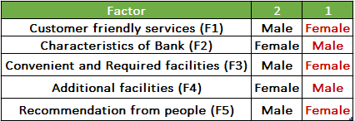
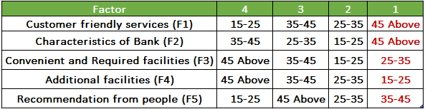
GENDER
AGE

Slide 72
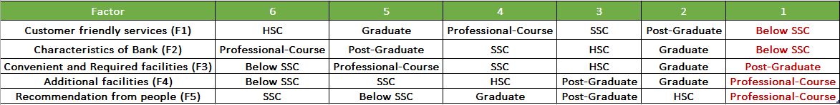
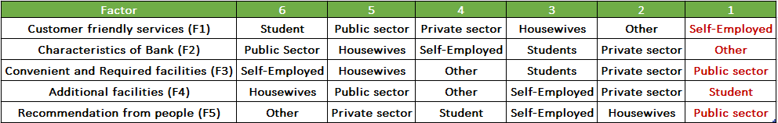
EDUCATIONAL LEVEL
OCCUPATION

Slide 73
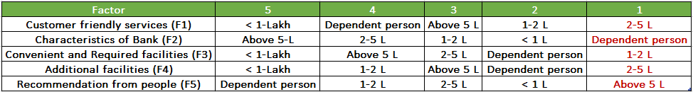
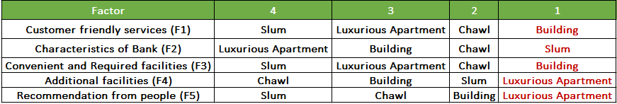
INCOME
HOUSING CONDITION

Slide 74



CONCLUSION

Slide 75
Public Bank
Occupation
Housing Condition
Private Bank
Father’s Education
Income
F1
F2
F3
F4
F5
Customer-Friendly Services
Characteristics of bank
Convenient and required facilities
Additional Facilities
Recommendation from people

Slide 76
Occupation
F1
F2
F3
F4
F5
Age
Educational Level
Gender
Housing Condition
Income
F3
F4
F5
F2
F5
F2
F3
F4
F5

Slide 77








Slide 78


OUR HEARTY THANKS TO…
Project Mentor Prof. Anil Arekar
Special Thanks to Dr. Santosh P. Gite
All Professors of Statistics Department for their valuable guidance
Entire non-teaching staff for their help

Slide 79




TEAM MEMBERS
PRIYA KALWAR
SHANTIKRISHNA PANICKER
SALIM SHAIKH
ANKITA SAMEL
NITHYA ESAKI

Slide 80

THANK YOU!

Slide 81
ANY QUESTIONS ?

